Slide 1
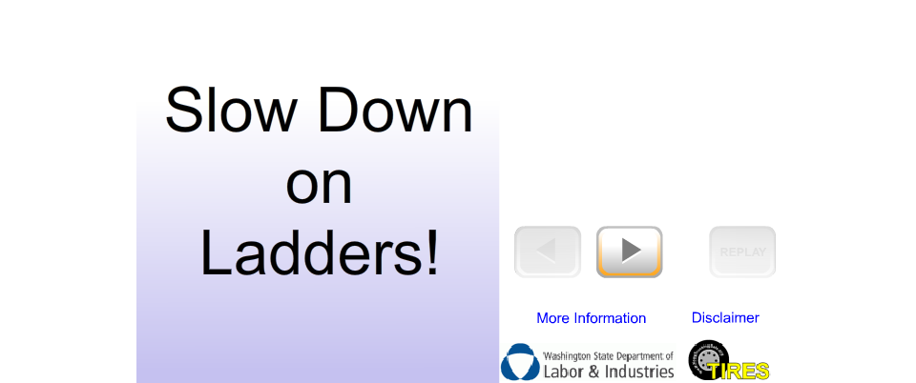
Shift+F5
to play
animation
Shift+F5
to play
animation
Shift+F5
To play
animation

